Slide 1
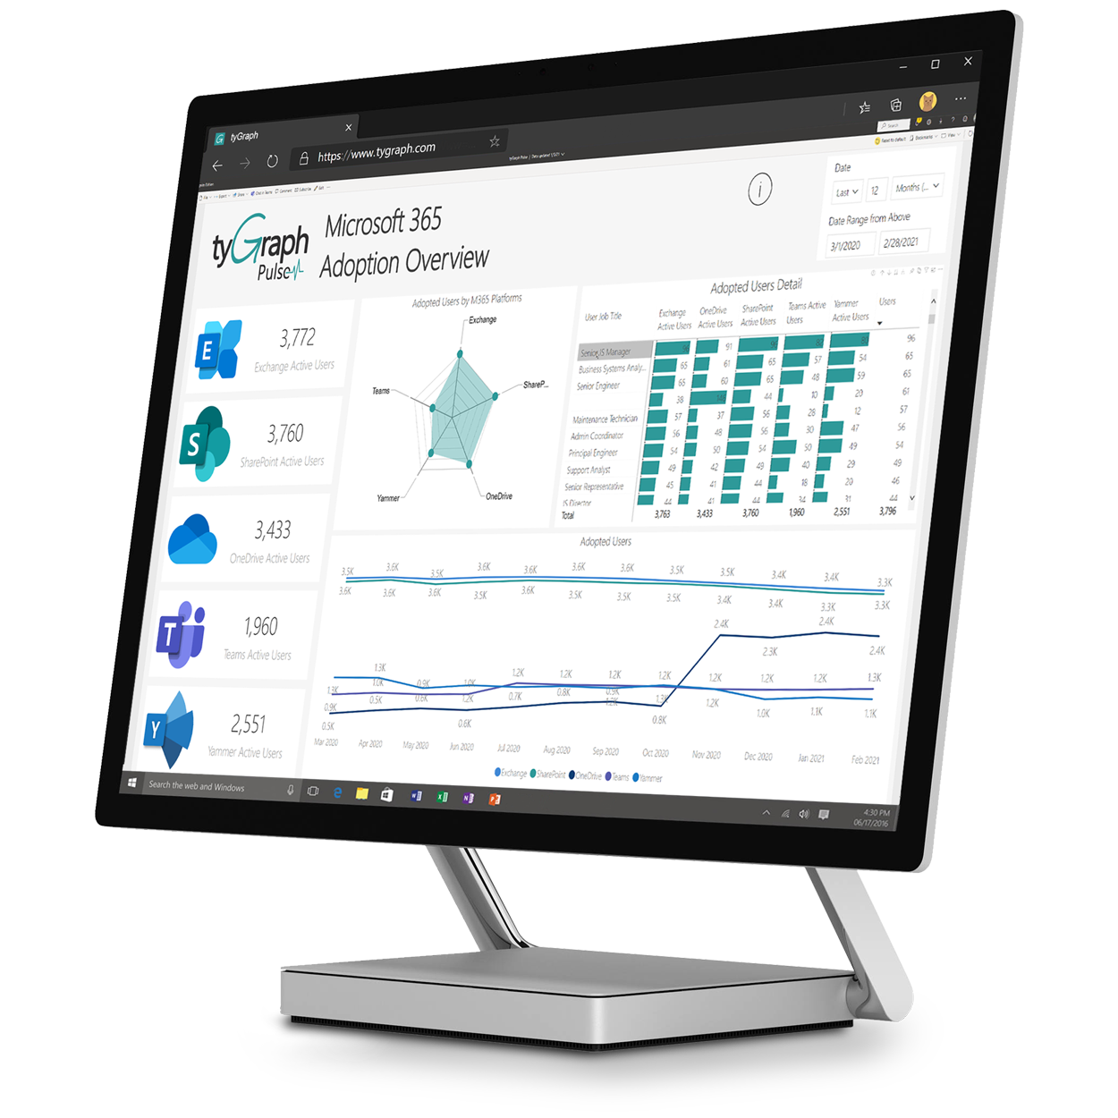
Connect Dataverse to Microsoft Teams
Norm Young
Microsoft MVP (M365 Apps & Services)
July 2022

Slide 2

Business Problem
Scenario
Technical
Problem
Our
Solution
Hundreds of customer channels in Teams
Files and Conversations critical to customer success story
Repeated and inefficient manual lookup
No Microsoft Teams integration in Dataverse Model-driven apps
Dynamics 365 only
Power Automate to collect customer channels
Link Account to channel
Dynamic “Open Teams” via Command Bar in Model-driven app

Slide 3




Solution
1
5
Customers
Model-driven
Get Channels
Channels Table
Create link
Accounts Table
2
3
6
4
Customer channels in multiple teams - 200 channel limit / team.
Flow collects channel info and stores in a Channels table (multiple times per day)
Channels table includes name, team name, link to channel
Account table has look-up to Channels table to create the link between Account and Channel
Model-driven app allows users to connect Account to Teams channel
Flow creates “msteams” link and copies value to Account for use with Power Fx

Slide 4
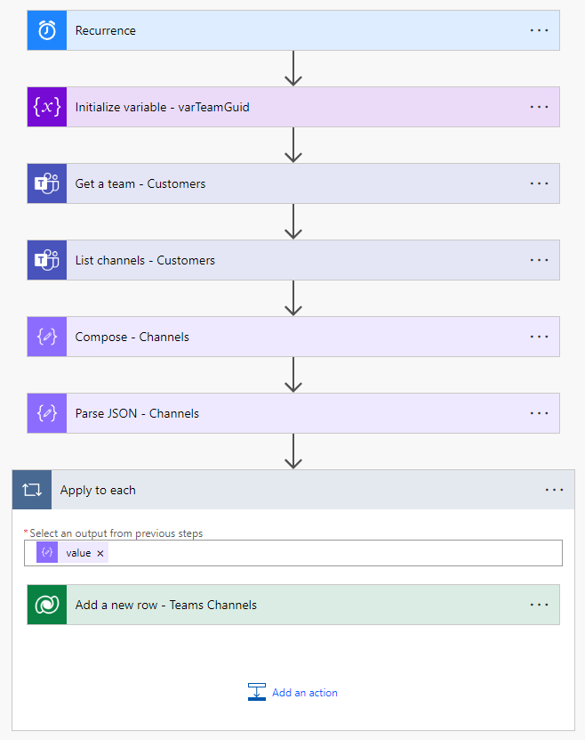
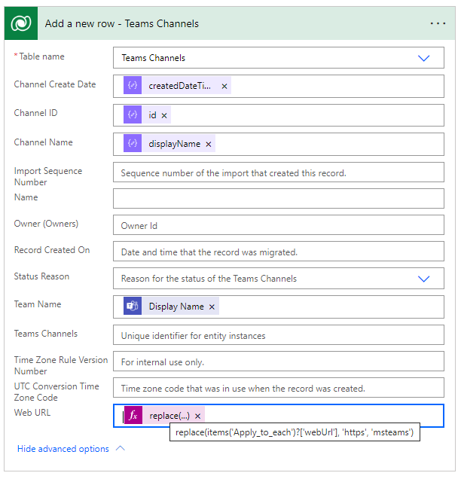
Power Automate – Initial Harvest
Executed once per full Customer team
Variable to store the GUID of the Customer team
Get the team info
Get the channel listing
Compose and Parse channel listing for use with in the “Add a new row” action
For each channel add a new row
Web URL replaces “https” with “msteams”
This allows opening in Teams client

Slide 5
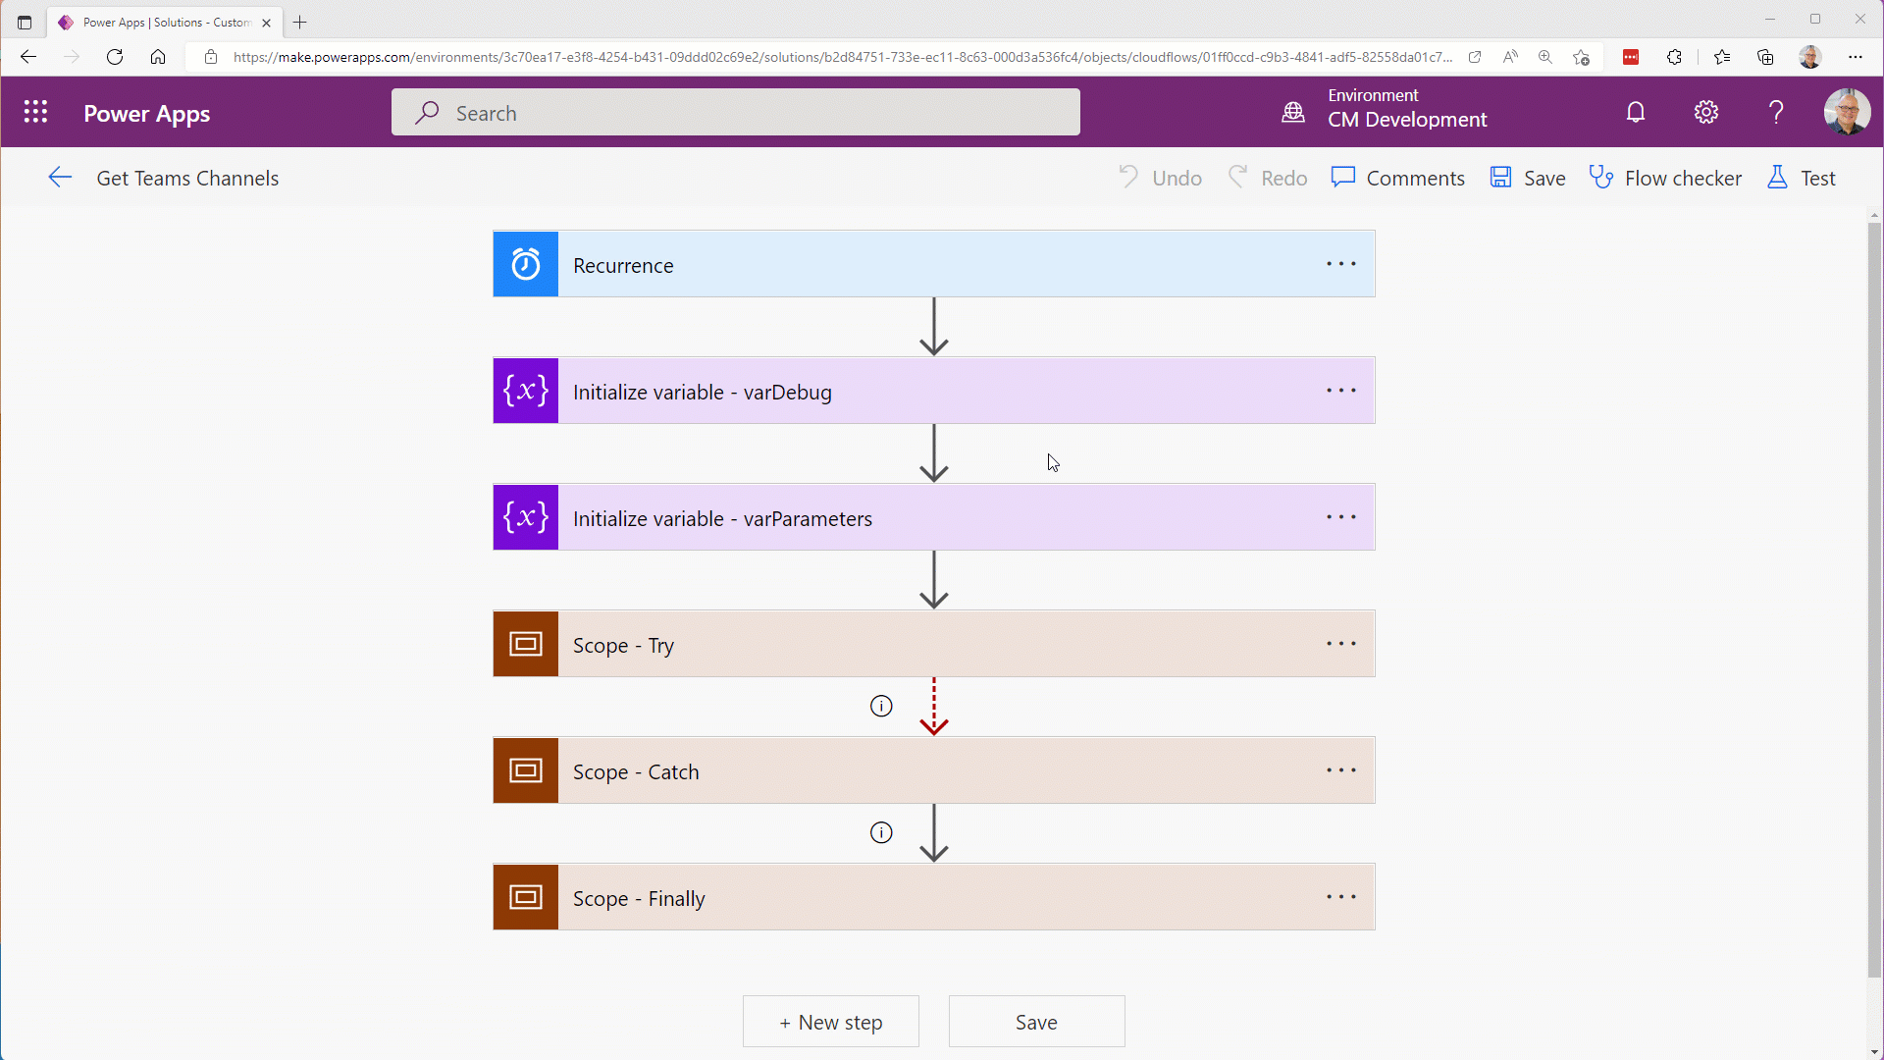
Power Automate - Get Channels
Executed multiple times per day against current Customer team
Variable to store the GUID of the Customer team
Get the team info
Get the channel listing
Compose and Parse channel listing for use with in the “Add a new row” action
For each channel add a new row
Web URL replaces “https” with “msteams”
This allows opening in Teams client

Slide 6
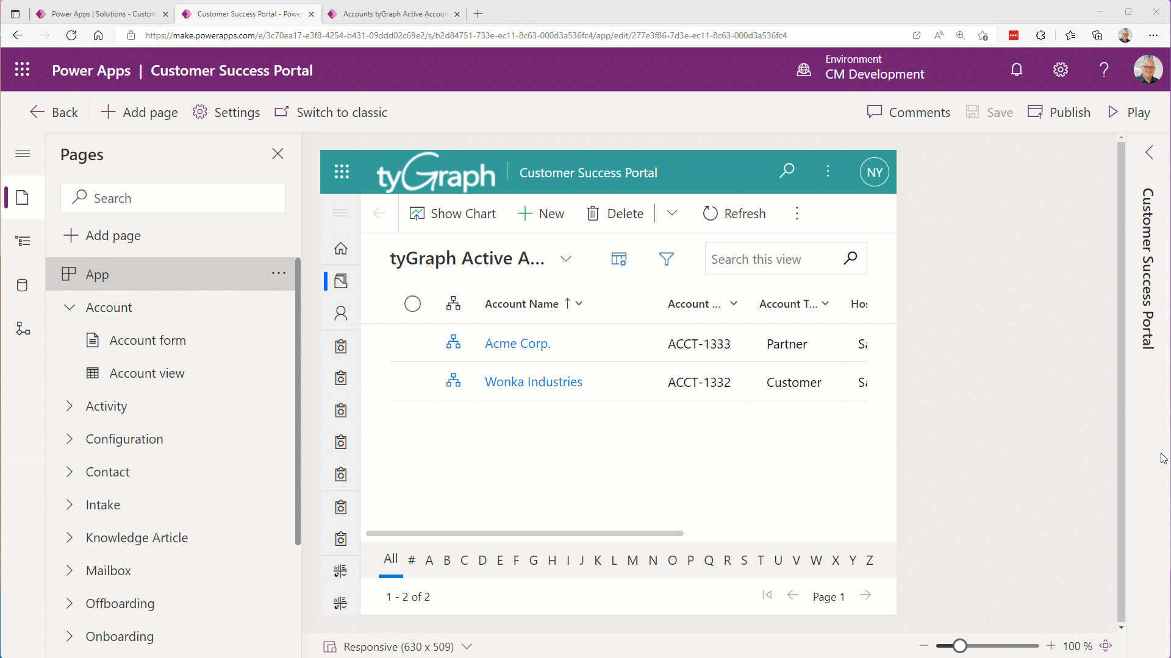
Power Apps – Command Bar
Model-driven app
Add a button to the Command Bar that will open the related customer channel
Account table Main form
Power Fx used to show/hide the button
Power Fx used to launch the “msteams” channel URL

Slide 7
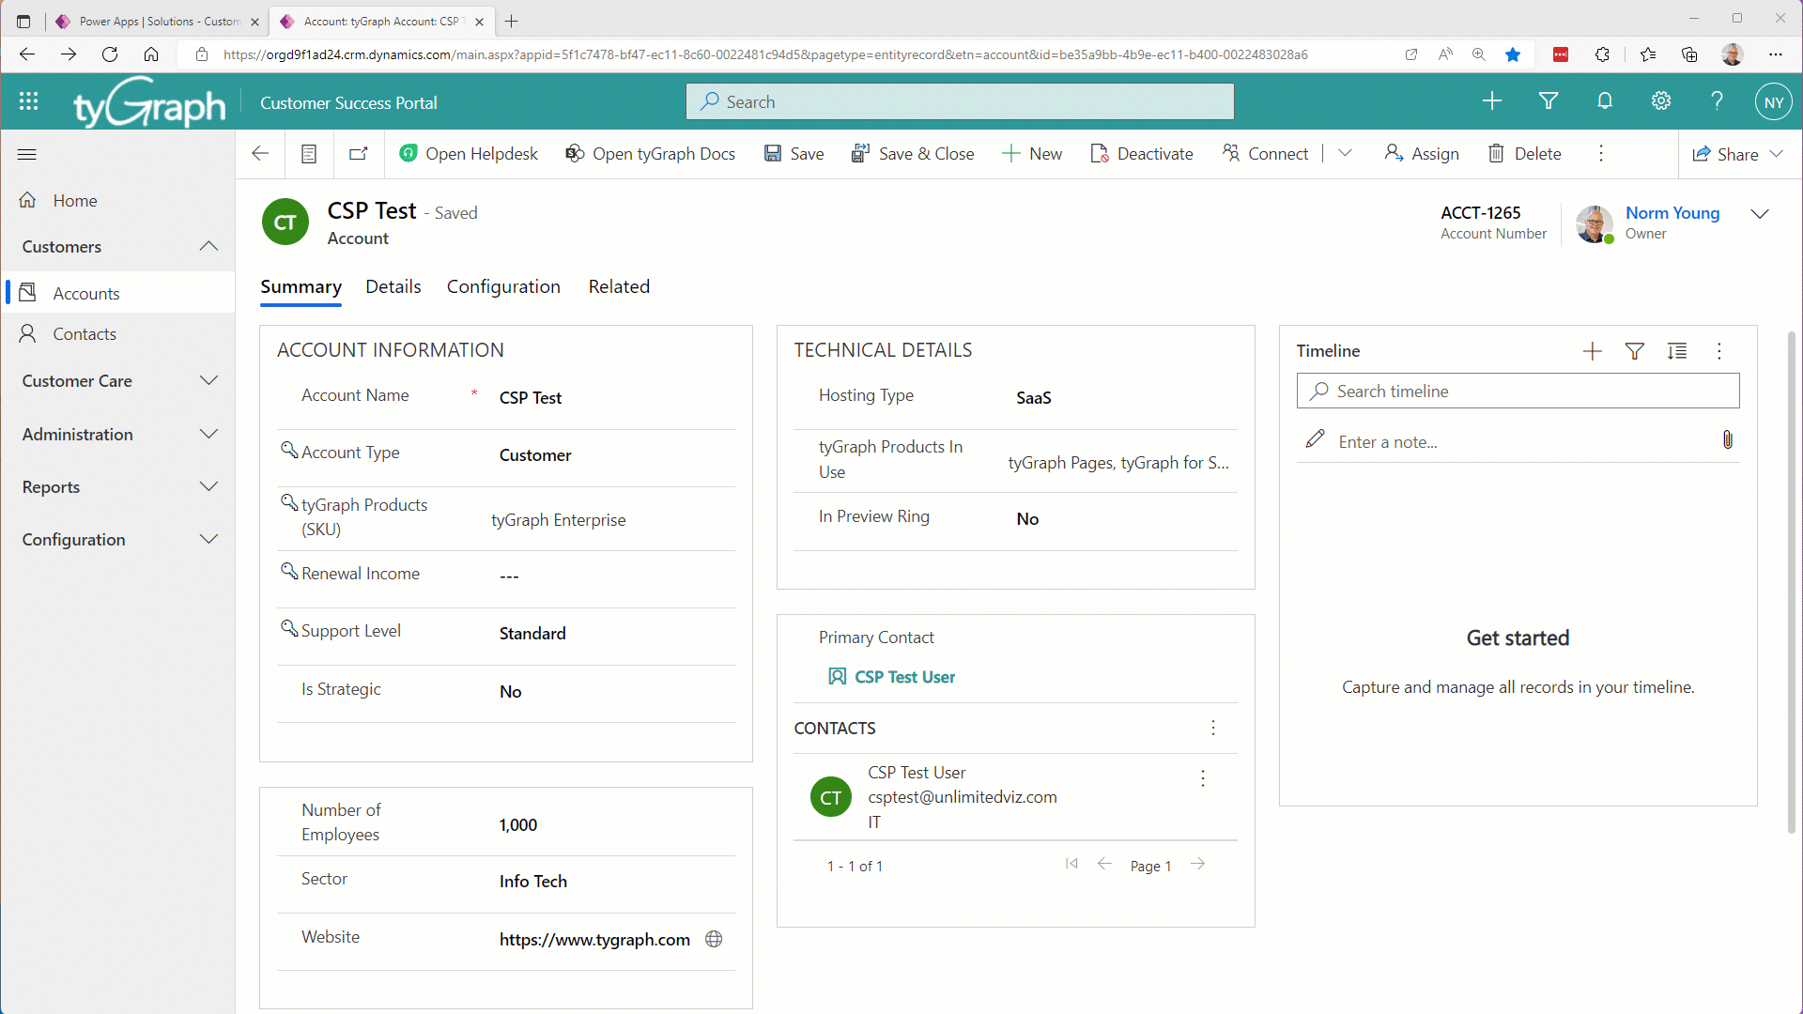
User Experience
From Account record
Select target channel
Flow copies URL to from Channel table to Account record
Copy required for Power Fx

Slide 8
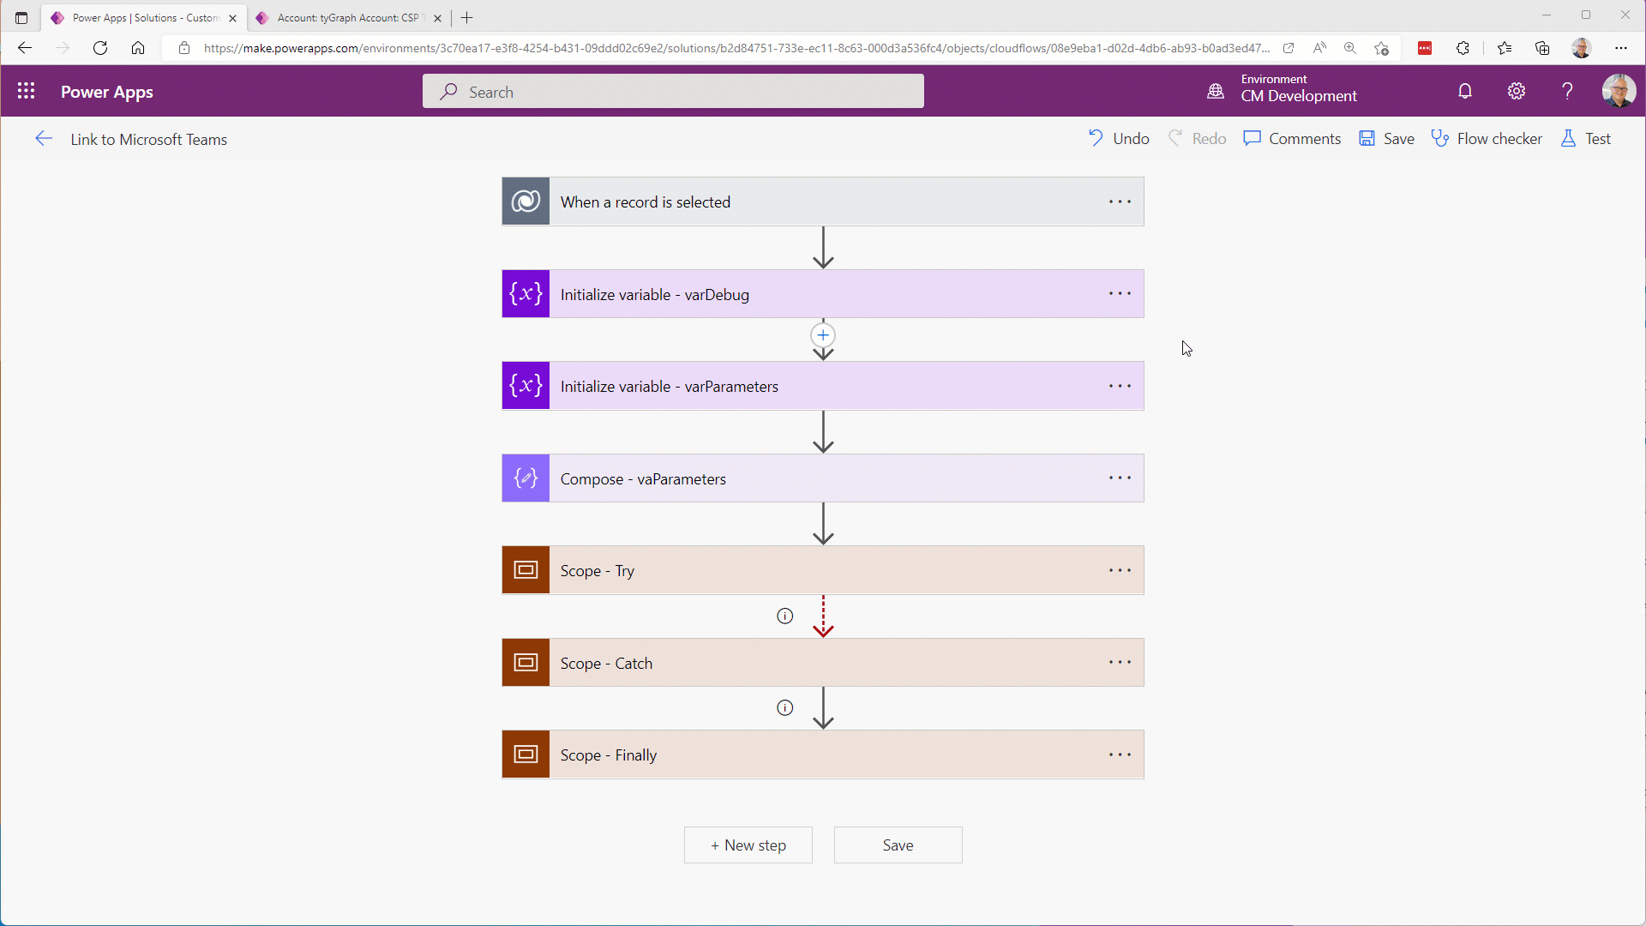
Power Automate – Link to Teams
Executed on demand
Get Account details
Get Channel details
Confirm that a Customer channel was selected
Update Account row
Send in-app notification
Catch errors
Notify Admin on error

Slide 9

Marginal gains
Value is added to the user experience by removing the manual lookup of the customer channel in MS Teams where there are hundreds of channels across multiple teams.
This marginal gain will give time back to my users, decrease friction in their work and allow them to focus on the business of work.

Slide 10
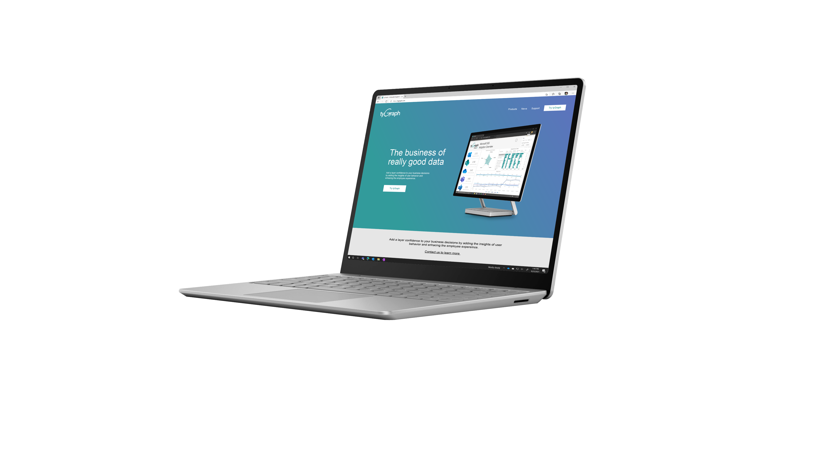
Thanks!!!
https://normyoung.ca
https://twitter.com/stormin_30
https://ca.linkedin.com/in/norm-young

